Slide 1


<Name>
<Date>

Slide 2

Outline
Executive Summary
Introduction
Methodology
Results
Conclusion
Appendix

Slide 3
Executive Summary
Summary of methodologies
Summary of all results

Slide 4
Introduction
Project background and context
Problems you want to find answers

Slide 5

Section 1

Slide 6
Methodology
Executive Summary
Data collection methodology:
The data was collected with SpaceX API and Web Scraping
Perform data wrangling
The data was processed with the Pandas library.
Perform exploratory data analysis (EDA) using visualization and SQL
Perform interactive visual analytics using Folium and Plotly Dash
Perform predictive analysis using classification models
How to build, tune, evaluate classification models

Slide 7
Data Collection
The data was collected by using the official SpaceX API
In the data collection I also used the SpaceX Wikipedia page, web scraped it to get more information.

Slide 8
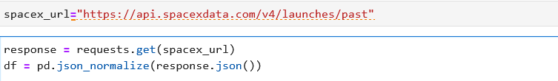
Data Collection – SpaceX API
I used the Request library to get information from the SpaceX API, and then turned it into a JSON format then a Data Frame
https://github.com/MagyarEper/DataScienceCapstoneProject/blob/main/jupyter-labs-webscraping.ipynb

Slide 9
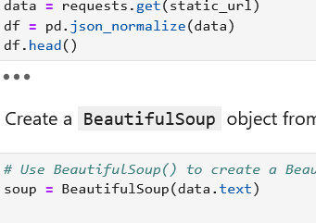
Data Collection - Scraping
I used Beautiful Soup Library to scrape the data from the Wikipedia page, then transformed and analyzed it
https://github.com/MagyarEper/DataScienceCapstoneProject/blob/main/jupyter-labs-spacex-data-collection-api.ipynb

Slide 10
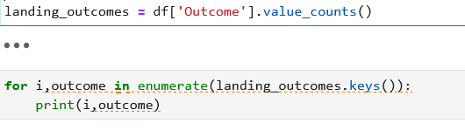
Data Wrangling
I Processed the gathered data by looking at different statistics and data points.
https://github.com/MagyarEper/DataScienceCapstoneProject/blob/main/labs-jupyter-spacex-Data%20wrangling.ipynb

Slide 11
EDA with Data Visualization
For the EDA with Data Vizualization part I used many different type of charts and plots to analyze the data.

Slide 12
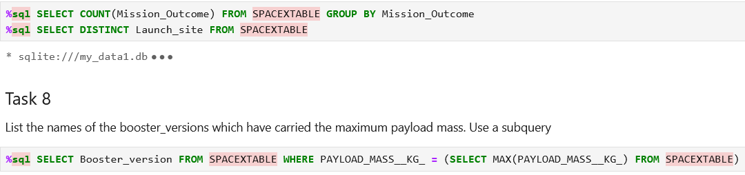
EDA with SQL
By using different SQL queries I explored the data further to get more insight.
https://github.com/MagyarEper/DataScienceCapstoneProject/blob/main/jupyter-labs-eda-sql-coursera_sqllite.ipynb

Slide 13
Build an Interactive Map with Folium
Summarize what map objects such as markers, circles, lines, etc. you created and added to a folium map
Explain why you added those objects
Add the GitHub URL of your completed interactive map with Folium map, as an external reference and peer-review purpose

Slide 14
Build a Dashboard with Plotly Dash
Summarize what plots/graphs and interactions you have added to a dashboard
Explain why you added those plots and interactions
Add the GitHub URL of your completed Plotly Dash lab, as an external reference and peer-review purpose

Slide 15
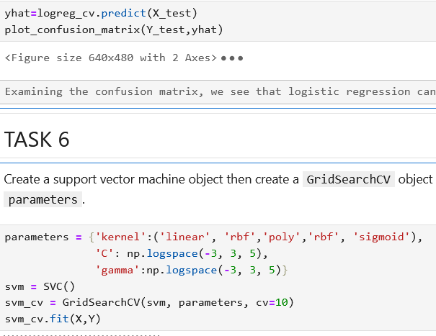
Predictive Analysis (Classification)
In this section I tried different machine learning models to accurately make predictions about the dataset.
https://github.com/MagyarEper/DataScienceCapstoneProject/blob/main/SpaceX_Machine%20Learning%20Prediction_Part_5.ipynb

Slide 16
Results
Exploratory data analysis results
Interactive analytics demo in screenshots
Predictive analysis results

Slide 17

Section 2

Slide 18
Flight Number vs. Launch Site
Show a scatter plot of Flight Number vs. Launch Site
Show the screenshot of the scatter plot with explanations

Slide 19
Payload vs. Launch Site
Show a scatter plot of Payload vs. Launch Site
Show the screenshot of the scatter plot with explanations

Slide 20
Success Rate vs. Orbit Type
Show a bar chart for the success rate of each orbit type
Show the screenshot of the scatter plot with explanations

Slide 21
Flight Number vs. Orbit Type
Show a scatter point of Flight number vs. Orbit type
Show the screenshot of the scatter plot with explanations

Slide 22
Payload vs. Orbit Type
Show a scatter point of payload vs. orbit type
Show the screenshot of the scatter plot with explanations

Slide 23
Launch Success Yearly Trend
Show a line chart of yearly average success rate
Show the screenshot of the scatter plot with explanations

Slide 24
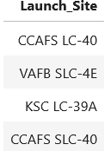
All Launch Site Names
There are four unique Launch sites in the dataset.

Slide 25
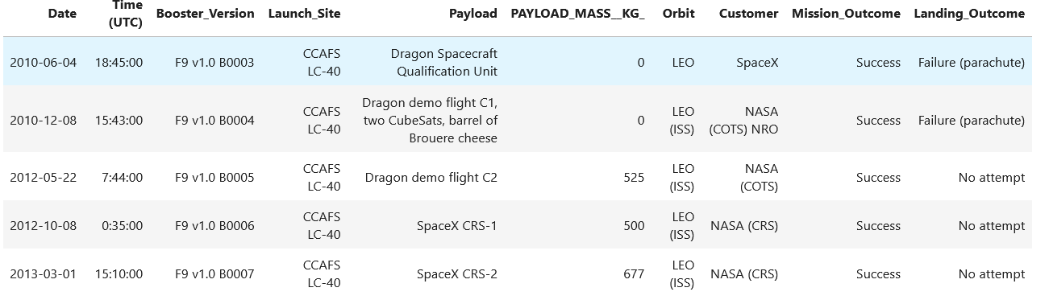
Launch Site Names Begin with 'CCA'
The top five result where the launch site begins with CCA

Slide 26
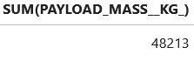
Total Payload Mass
The total payload carried by boosters from NASA was 48.213 KG

Slide 27
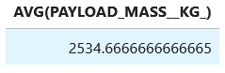
Average Payload Mass by F9 v1.1
The average payload mass carried by booster version F9 v1.1

Slide 28
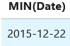
First Successful Ground Landing Date
The date of the first successful landing outcome on ground pad was 2015.12.22.

Slide 29
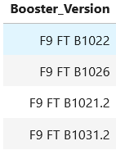
Successful Drone Ship Landing with Payload between 4000 and 6000
Names of boosters which have successfully landed on drone ship and had payload mass greater than 4000 but less than 6000

Slide 30
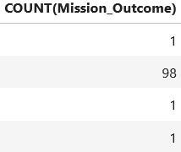
Total Number of Successful and Failure Mission Outcomes
The total number of successful and failure mission outcomes

Slide 31
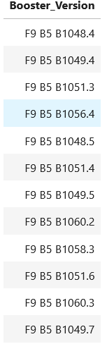
Boosters Carried Maximum Payload
Names of the booster which have carried the maximum payload mass

Slide 32
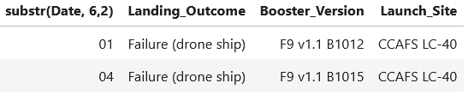
2015 Launch Records
The failed landing_outcomes in drone ship, their booster versions, and launch site names for in year 2015

Slide 33
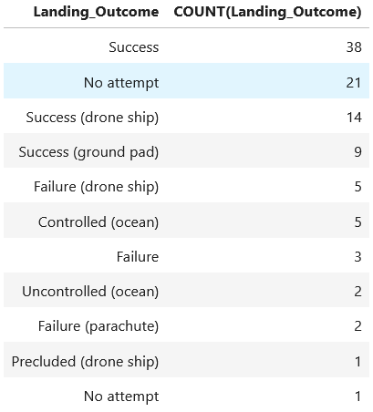
Rank Landing Outcomes Between 2010-06-04 and 2017-03-20
Count of landing outcomes (such as Failure (drone ship) or Success (ground pad)) between the date 2010-06-04 and 2017-03-20, in descending order.

Slide 34

Section 3

Slide 35
<Folium Map Screenshot 1>
Replace <Folium map screenshot 1> title with an appropriate title
Explore the generated folium map and make a proper screenshot to include all launch sites’ location markers on a global map
Explain the important elements and findings on the screenshot

Slide 36
<Folium Map Screenshot 2>
Replace <Folium map screenshot 2> title with an appropriate title
Explore the folium map and make a proper screenshot to show the color-labeled launch outcomes on the map
Explain the important elements and findings on the screenshot

Slide 37
<Folium Map Screenshot 3>
Replace <Folium map screenshot 3> title with an appropriate title
Explore the generated folium map and show the screenshot of a selected launch site to its proximities such as railway, highway, coastline, with distance calculated and displayed
Explain the important elements and findings on the screenshot

Slide 38

Section 4

Slide 39
<Dashboard Screenshot 1>
Replace <Dashboard screenshot 1> title with an appropriate title
Show the screenshot of launch success count for all sites, in a piechart
Explain the important elements and findings on the screenshot

Slide 40
<Dashboard Screenshot 2>
Replace <Dashboard screenshot 2> title with an appropriate title
Show the screenshot of the piechart for the launch site with highest launch success ratio
Explain the important elements and findings on the screenshot

Slide 41
<Dashboard Screenshot 3>
Replace <Dashboard screenshot 3> title with an appropriate title
Show screenshots of Payload vs. Launch Outcome scatter plot for all sites, with different payload selected in the range slider
Explain the important elements and findings on the screenshot, such as which payload range or booster version have the largest success rate, etc.

Slide 42

Section 5

Slide 43
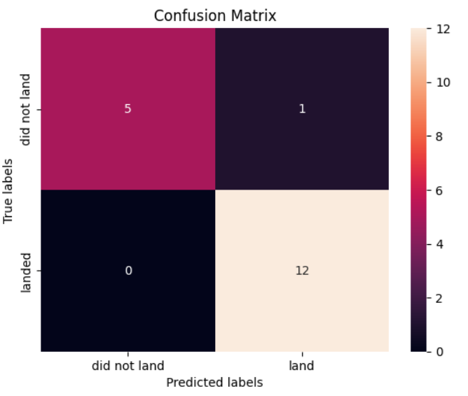
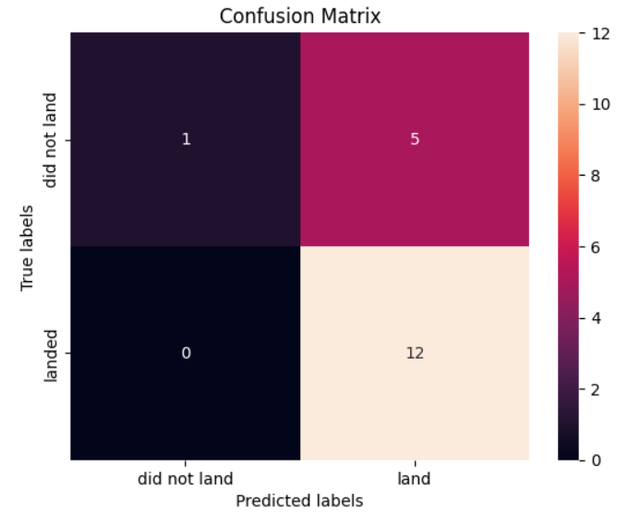
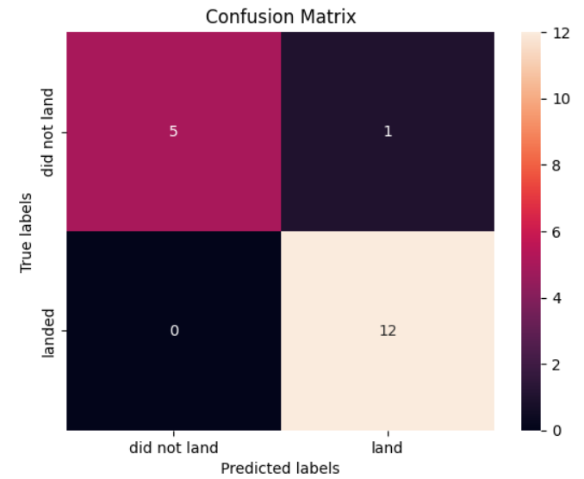
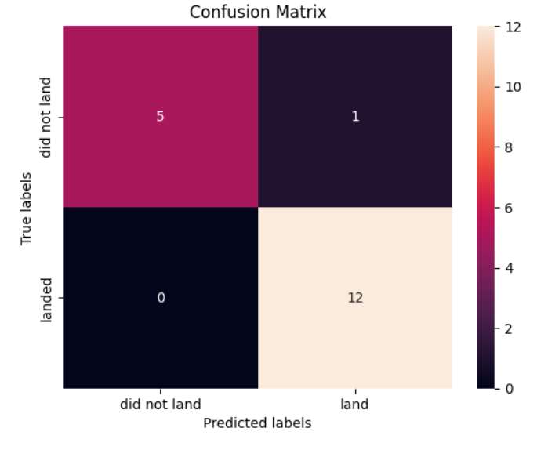
Classification Accuracy
Logistic regression:
Accuracy: 0.82222
Decision tree:
Accuracy: 0.9222
Support Vector Machine:
Accuracy: 0.82222
K Nearest Neighbor:
Accuracy: 0.84444

Slide 44
Confusion Matrix
Show the confusion matrix of the best performing model with an explanation

Slide 45
Conclusions
Point 1
Point 2
Point 3
Point 4
…

Slide 46
Appendix
Include any relevant assets like Python code snippets, SQL queries, charts, Notebook outputs, or data sets that you may have created during this project

Slide 47


